Slide 1
THE EXERCISE
Consider the topology shown in Figure 4.17. Denote the three subnets with hosts (starting clockwise at 12:00) as Networks A, B, and C. Denote the sub-nets without hosts as Networks D, E, and F.
a) Assign network addresses to each of these six subnets, with the follow-ing constraints: All addresses must be allocated from 214.97.254/23; Subnet A should have enough addresses to support 250 interfaces; Sub-net B should have enough addresses to support 120 interfaces; and Subnet C should have enough addresses to support 120 interfaces. Of course, subnets D, E and F should each be able to support two interfaces. For each subnet, the assignment should take the form a.b.c.d/x or a.b.c.d/x – e.f.g.h/y.
b) Using your answer to part (a), provide the forwarding tables (using longest prefix matching) for each of the three routers.

Slide 2
ISP assigns: 214.97.254.0/23 Requirements:
Network A: 250 hosts
Network B: 120 interfaces
Network C: 120 end systems
Networks D, E and F: 2 interfaces
A
RA
F
D
Network A: /24
Network B: /25
Network C: /25
Not enough addresses!!
DO NOT follow existing solution out there
Not a good solution for this course
Really weird solution…
RC
RB
E
C
B

Slide 3
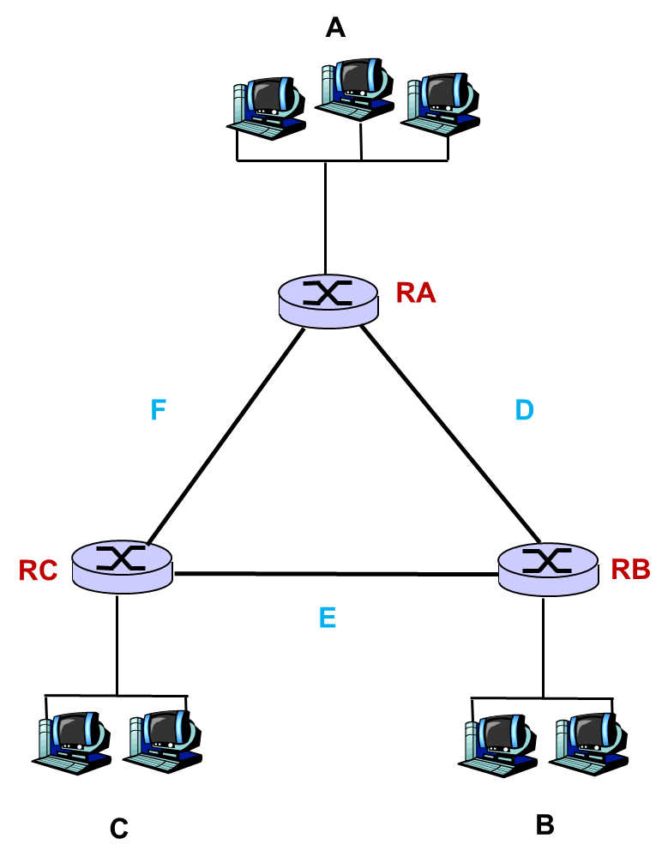
THE EXERCISE
Consider the topology of the following picture.
a) Assign addresses to the each one other 6 subnets taking into account the following requirements: all the addresses must be assigned from 128.119.252.0/23; subnet A must be able to hold up to 126 hosts; subnet B must be able to hold up to 62 interfaces and subnet C must hold up to 15 end systems. Of course subnets D, E and F should support two interfaces. Assign the addresses using the format a.b.c.d/x.
b) Using your answer to part (a), provide the forwarding tables (using longest prefix matching) for each of the three routers using the following format: destination IP / prefix / next hop (write the IP address using decimal numbers and the prefix using ’/[0..32]’).

